Slide 1
CRYPTOGRAPHY & NETWORK SECURITY
DR.K.SURESH BABU
M.TECH., PH.D.
PROFESSOR OF CSE
OFFICER IN-CHARGE EXAMINATIONS
CISCO CERTIFIED ACADEMY INSTRUCTOR(CCAI)
UNIVERSITY COLLEGE OF ENGG. SCI. & TECH. HYDERABAD
JNT UNIVERSITY HYDERABAD

Slide 2
Background
Information Security requirements have changed in recent times
traditionally provided by physical and administrative mechanisms
computer use requires automated tools to protect files and other stored information
use of networks and communications links requires measures to protect data during transmission
Notes:
The requirements of information security within an organization have undergone two major changes in the last several decades. Before the widespread use of data processing equipment,the security of information felt to be valuable to an organization was provided primarily by physical (eg. rugged filing cabinets with locks) and administrative mechanisms (eg. Personnel screening procedures during hiring process).
Growing computer use implies a need for automated tools for protecting files and other information stored on it. This is especially the case for a shared system, such as a time-sharing system, and even more so for systems that can be accessed over a public telephone network, data network, or the Internet.
The second major change that affected security is the introduction of distributed systems and the use of networks and communications facilities for carrying data between terminal user and computer and between computer and computer. Network security measures are needed to protect data during their transmission.

Slide 3
Why We Need Information Security?
Because there are threats
Threats
A threat is an object, person, or other entity that represents a constant danger to an asset

Slide 4
As per the CSI Survey
494 computer security practitioners
46% suffered security incidents
29% reported to law enforcement
Average annual loss $350,424
1/5 suffered ‗targeted attack‘
The source of the greatest financial losses?
Most prevalent security problem
Insider abuse of network access
Email

Slide 5
Threat Categories
Acts of human error or failure
Compromises to intellectual property
Deliberate acts of espionage or trespass
Deliberate acts of information extortion
Deliberate acts of sabotage or vandalism
Deliberate acts of theft
Deliberate software attack
Forces of nature
Deviations in quality of service
Technical hardware failures or errors
Technical software failures or errors
Technological obsolesce

Slide 6
Definitions
Computer Security - generic name for the collection of tools designed to protect data and to thwart hackers
Network Security - measures to protect data during their transmission
Internet Security - measures to protect data during their transmission over a collection of interconnected networks
Notes:
Here are some key definitions, note boundaries between them are blurred.

Slide 7

Focus of Course
Our focus is on Security =>Internet Security
which consists of measures to deter, prevent, detect, and correct security violations that involve the transmission & storage of information
Notes:
Detail the focus of this book/course, which is on Internet Security - being measures to deter, prevent, detect, and correct security violations that involve the transmission & storage of information.

Slide 8
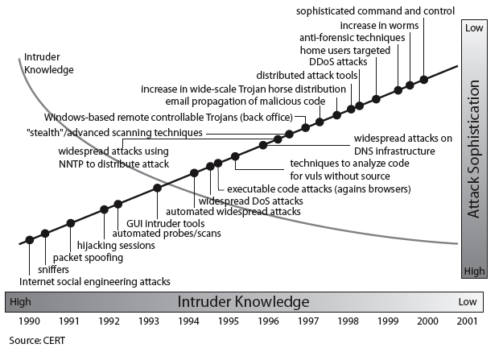
Security Trends
Notes:
Discuss observed security trends (Stallings section 1.1 & Figure 1.2 above), noting growth in sophistication of attacks contrasting with decrease in skill & knowledge needed to mount an attack.

Slide 9
ASPECTS OF SECURITY
  Consider 3 aspects of information security:
    Security Attack
    Security Mechanism
    Security Service
BILL FIGG

Slide 10
SECURITY ATTACK
  any action that compromises the security of information owned by an organization
  information security is about how to prevent attacks, or failing that, to detect attacks on information-based systems
  often threat & attack used to mean same thing
  have a wide range of attacks
BILL FIGG

Slide 11
Classify Security Attacks
passive attacks - eavesdropping on, or monitoring of, transmissions to:
  obtain message contents, or
  monitor traffic flows
active attacks – modification of data stream to:
  masquerade of one entity as some other
  replay previous messages
  modify messages in transit
  denial of service
BILL FIGG

Slide 12
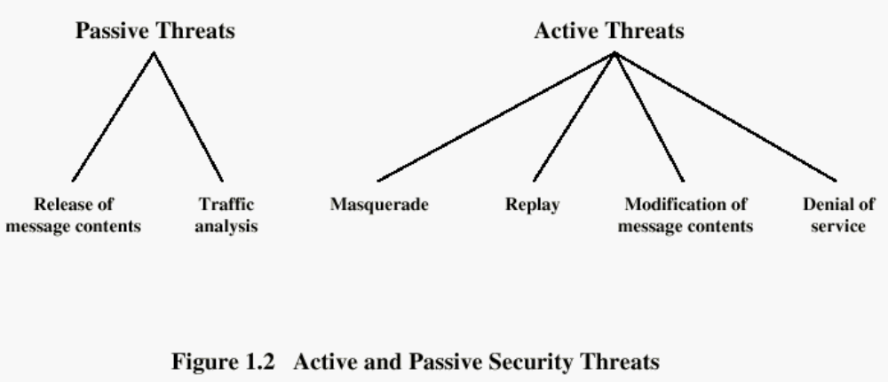
Types of Attacks
BILL FIGG

Slide 13
Security Threats
Interruption
Interception
Modification
Fabrication
BILL FIGG

Slide 14
INTERRUPTION
An asset of the system is destroyed or becomes unavailable or unusable. It is an attack on availability.
Examples:
  Destruction of some hardware
  Jamming wireless signals
  Disabling file management systems
BILL FIGG

Slide 15
INTERCEPTION
An unauthorized party gains access to an asset. Attack on confidentiality.
Examples:
  Wire tapping to capture data in a network.
  Illicitly copying data or programs
  Eavesdropping
BILL FIGG

Slide 16
MODIFICATION
When an unauthorized party gains access and tampers an asset. Attack is on Integrity.
Examples:
  Changing data file
Altering a program and the contents of a message
BILL FIGG

Slide 17
FABRICATION
An unauthorized party inserts a counterfeit object into the system. Attack on Authenticity. Also called impersonation
Examples:
  Hackers gaining access to a personal email and sending message
  Insertion of records in data files
Insertion of spurious messages in a network
BILL FIGG

Slide 18
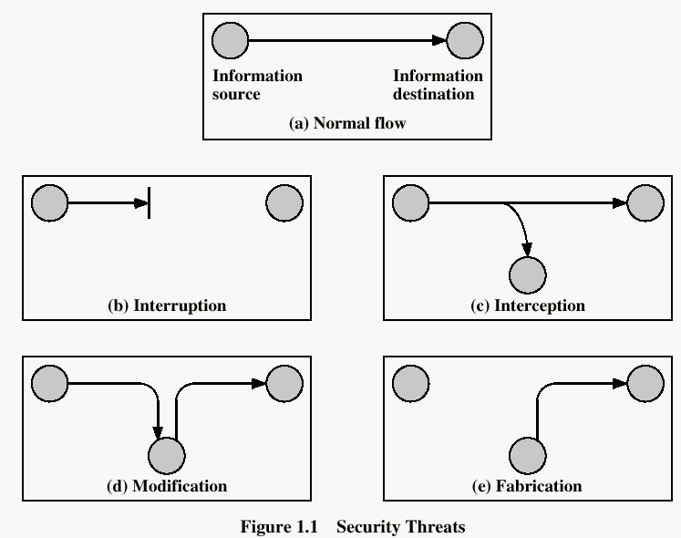
Secutiy Threats
BILL FIGG

Slide 19
Security Services
X.800 defines it as: a service provided by a protocol layer of communicating open systems, which ensures adequate security of the systems or of data transfers
RFC 2828 defines it as: a processing or communication service provided by a system to give a specific kind of protection to system resources
X.800 defines it in 5 major categories
It is a processing or communication service that is provided by a system to give a specific kind of production to system resources. Security services implement security policies and are implemented by security mechanisms.
BILL FIGG

Slide 20
Security Services
Confidentiality
Confidentiality is the protection of transmitted data from passive attacks.
It is used to prevent the disclosure of information to unauthorized individuals or systems. It has been defined as “ensuring that information is accessible only to those authorized to have access”.
The other aspect of confidentiality is the protection of traffic flow from analysis.
Ex: A credit card number has to be secured during online transaction.
BILL FIGG

Slide 21
Authentication
This service assures that a communication is authentic.
For a single message transmission, its function is to assure the recipient that the message is from intended source.
For an ongoing interaction two aspects are involved. First, during connection initiation the service assures the authenticity of both parties. Second, the connection between the two hosts is not interfered allowing a third party to masquerade as one of the two parties.
Two specific authentication services defines in X.800 are
Peer entity authentication: Verifies the identities of the peer entities involved in communication. Provides use at time of connection establishment and during data transmission. Provides confidence against a masquerade or a replay attack
Data origin authentication: Assumes the authenticity of source of data unit, but does not provide protection against duplication or modification of data units. Supports applications like electronic mail, where no prior interactions take place between communicating entities.
BILL FIGG

Slide 22
Integrity
Integrity means that data cannot be modified without authorization.
Like confidentiality, it can be applied to a stream of messages, a single message or selected fields within a message.
Two types of integrity services are available. They are
Connection-Oriented Integrity Service: This service deals with a stream of messages, assures that messages are received as sent, with no duplication, insertion, modification, reordering or replays. Destruction of data is also covered here. Hence, it attends to both message stream modification and denial of service.
Connectionless-Oriented Integrity Service: It deals with individual messages regardless of larger context, providing protection against message modification only.
An integrity service can be applied with or without recovery. Because it is related to active attacks, major concern will be detection rather than prevention. If a violation is detected and the service reports it, either human intervention or automated recovery machines are required to recover.
BILL FIGG

Slide 23
Non-repudiation
Non-repudiation prevents either sender or receiver from denying a transmitted message.
This capability is crucial to e-commerce. Without it an individual or entity can deny that he, she or it is responsible for a transaction, therefore not financially liable.
BILL FIGG

Slide 24
Access Control
This refers to the ability to control the level of access that individuals or entities have to a network or system and how much information they can receive. It is the ability to limit and control the access to host systems and applications via communication links. For this, each entity trying to gain access must first be identified or authenticated, so that access rights can be tailored to the individuals.
BILL FIGG

Slide 25
Availability
It is defined to be the property of a system or a system resource being accessible and usable upon demand by an authorized system entity. The availability can significantly be affected by a variety of attacks, some amenable to automated counter measures i.e authentication and encryption and others need some sort of physical action to prevent or recover from loss of availability of elements of a distributed system.
BILL FIGG

Slide 26
Security Services (X.800)
Authentication - assurance that the communicating entity is the one claimed
Access Control - prevention of the unauthorized use of a resource
Data Confidentiality –protection of data from unauthorized disclosure
Data Integrity - assurance that data received is as sent by an authorized entity
Non-Repudiation - protection against denial by one of the parties in a communication
BILL FIGG

Slide 27
Security Mechanism
feature designed to detect, prevent, or recover from a security attack
no single mechanism that will support all services required
however one particular element underlies many of the security mechanisms in use:
  cryptographic techniques
hence our focus on this topic
Notes:
Now introduce “Security Mechanism” which are the specific means of implementing one or more security services.
Note these mechanisms span a wide range of technical components, but one aspect seen in many is the use of cryptographic techniques.

Slide 28
Security Mechanisms (X.800)
specific security mechanisms:
  encipherment, digital signatures, access controls, data integrity, authentication exchange, traffic padding, routing control, notarization
pervasive security mechanisms:
  trusted functionality, security labels, event detection, security audit trails, security recovery
BILL FIGG

Slide 29
Specific Security Mechanisms
Encipherment: It refers to the process of applying mathematical algorithms for converting data into a form that is not intelligible. This depends on algorithm used and encryption keys.
Digital Signature: The appended data or a cryptographic transformation applied to any data unit allowing to prove the source and integrity of the data unit and protect against forgery.
Access Control: A variety of techniques used for enforcing access permissions to the system resources.
Data Integrity: A variety of mechanisms used to assure the integrity of a data unit or stream of data units.
Authentication Exchange: A mechanism intended to ensure the identity of an entity by means of information exchange.
Traffic Padding: The insertion of bits into gaps in a data stream to frustrate traffic analysis attempts.
Routing Control: Enables selection of particular physically secure routes for certain data and allows routing changes once a breach of security is suspected.
Notarization: The use of a trusted third party to assure certain properties of a data exchange
BILL FIGG

Slide 30
Pervasive Security Mechanisms
Trusted Functionality: That which is perceived to b correct with respect to some criteria Security Level: The marking bound to a resource (which may be a data unit) that names or designates the security attributes of that resource.
Event Detection: It is the process of detecting all the events related to network security. Security Audit Trail: Data collected and potentially used to facilitate a security audit, which is an independent review and examination of system records and activities.
Security Recovery: It deals with requests from mechanisms, such as event handling and management functions, and takes recovery actions.
BILL FIGG

Slide 31

Model for Network Security
Notes:
In considering the place of encryption, its useful to use the following two models from Stallings section 1.6.
The first, illustrated in Figure 1.5, models information flowing over an insecure communications channel, in the presence of possible opponents. Hence an appropriate security transform (encryption algorithm) can be used, with suitable keys, possibly negotiated using the presence of a trusted third party.

Slide 32
Model for Network Security
using this model requires us to:
  design a suitable algorithm for the security transformation
  generate the secret information (keys) used by the algorithm
  develop methods to distribute and share the secret information
  specify a protocol enabling the principals to use the transformation and secret information for a security service
Notes:
This general model shows that there are four basic tasks in designing a particular security service, as listed.

Slide 33

Model for Network Access Security
Notes:
The second, illustrated in Figure 1.6, model is concerned with controlled access to information or resources on a computer system, in the presence of possible opponents. Here appropriate controls are needed on the access and within the system, to provide suitable security. Some cryptographic techniques are useful here also.

Slide 34
Some Basic Terminology
plaintext - original message
ciphertext - coded message
cipher - algorithm for transforming plaintext to ciphertext
key - info used in cipher known only to sender/receiver
encipher (encrypt) - converting plaintext to ciphertext
decipher (decrypt) - recovering ciphertext from plaintext
cryptography - study of encryption principles/methods
cryptanalysis (codebreaking) - study of principles/ methods of deciphering ciphertext without knowing key
cryptology - field of both cryptography and cryptanalysis
Notes:
Briefly review some terminology used throughout the course.

Slide 35
CRYPTOGRAPHY
Cryptographic systems are generally classified along 3 independent dimensions:
Type of operations used for transforming plain text to cipher text
All the encryption algorithms are abased on two general principles: substitution, in which each element in the plaintext is mapped into another element, and transposition, in which elements in the plaintext are rearranged.
The number of keys used
If the sender and receiver uses same key then it is said to be symmetric key (or) single key (or) conventional encryption. If the sender and receiver use different keys then it is said to be public key encryption.
The way in which the plain text is processed
A block cipher processes the input and block of elements at a time, producing output block for each input block. A stream cipher processes the input elements continuously, producing output element one at a time, as it goes along.
BILL FIGG

Slide 36

Symmetric Cipher Model
Notes:
Detail the five ingredients of the symmetric cipher model, shown in Stallings Figure 2.1:
plaintext - original message
encryption algorithm – performs substitutions/transformations on plaintext
secret key – control exact substitutions/transformations used in encryption algorithm
ciphertext - scrambled message
decryption algorithm – inverse of encryption algorithm

Slide 37
Requirements
two requirements for secure use of symmetric encryption:
  a strong encryption algorithm
  a secret key known only to sender / receiver
mathematically have:
  Y = E_{K}(X)
  X = D_{K}(Y)
assume encryption algorithm is known
implies a secure channel to distribute key
Notes:
We assume that it is impractical to decrypt a message on the basis of the cipher- text plus knowledge of the encryption/decryption algorithm, and do not need to keep the algorithm secret; rather we only need to keep the key secret. This feature of symmetric encryption is what makes it feasible for widespread use. It allows easy distribution of s/w and h/w implementations.
Can take a closer look at the essential elements of a symmetric encryption scheme: mathematically it can be considered a pair of functions with: plaintext X, ciphertext Y, key K, encryption algorithm E_{K}, decryption algorithm D_{K}.

Slide 38
Cryptanalysis
objective to recover key not just message
general approaches:
  cryptanalytic attack
  brute-force attack
Notes:
Typically objective is to recover the key in use rather then simply to recover the plaintext of a single ciphertext.
There are two general approaches:
Cryptanalytic attacks rely on the nature of the algorithm plus perhaps some knowledge of the general characteristics of the plaintext or even some sample plaintext-ciphertext pairs.
Brute-force attacks try every possible key on a piece of ciphertext until an intelligible translation into plaintext is obtained. On average,half of all possible keys must be tried to achieve success.

Slide 39
CRYPTANALYSIS
The process of attempting to discover X or K or both is known as cryptanalysis. The strategy used by the cryptanalysis depends on the nature of the encryption scheme and the information available to the cryptanalyst.
There are various types of cryptanalytic attacks based on the amount of information known to the cryptanalyst.
Cipher text only – A copy of cipher text alone is known to the cryptanalyst.
Known plaintext – The cryptanalyst has a copy of the cipher text and the corresponding plaintext.
Chosen plaintext – The cryptanalysts gains temporary access to the encryption machine. They cannot open it to find the key, however; they can encrypt a large number of suitably chosen plaintexts and try to use the resulting cipher texts to deduce the key.
Chosen cipher text – The cryptanalyst obtains temporary access to the decryption machine, uses it to decrypt several string of symbols, and tries to use the results to deduce the key.
chosen text
  select plaintext or ciphertext to en/decrypt
BILL FIGG

Slide 40
Classical Encryption
Techniques
Many savages at the present day regard their names as vital parts of themselves, and therefore take great pains to conceal their real names, lest these should give to evil-disposed persons a handle by which to injure their owners. —The Golden Bough, Sir James George Frazer
BILL FIGG

Slide 41
Symmetric Encryption
or conventional / private-key / single-key
sender and recipient share a common key
all classical encryption algorithms are private-key
was only type prior to invention of public-key in 1970’s
BILL FIGG

Slide 42
CLASSICAL ENCRYPTION TECHNIQUES
There are two basic building blocks of all encryption techniques: substitution and transposition.
SUBSTITUTION TECHNIQUES : A substitution technique is one in which the letters of plaintext are replaced by other letters or by numbers or symbols. If the plaintext is viewed as a sequence of bits, then substitution involves replacing plaintext bit patterns with cipher text bit patterns.
CAESAR CIPHER, MONOALPHABETIC CIPHERS, PLAYFAIR CIPHERS, HILL CIPHER
POLYALPHABETIC CIPHERS
TRANSPOSITION TECHNIQUES All the techniques examined so far involve the substitution of a cipher text symbol for a plaintext symbol. A very different kind of mapping is achieved by performing some sort of permutation on the plaintext letters. This technique is referred to as a transposition cipher.
BILL FIGG

Slide 43
Caesar Cipher
earliest known substitution cipher
by Julius Caesar
first attested use in military affairs
replaces each letter by 3rd letter on
example:
  meet me after the toga party
  PHHW PH DIWHU WKH WRJD SDUWB
BILL FIGG

Slide 44
Caesar Cipher
can define transformation as:
  a b c d e f g h i j k l m n o p q r s t u v w x y z
  D E F G H I J K L M N O P Q R S T U V W X Y Z A B C
mathematically give each letter a number
  a b c d e f g h i j k l m n o p q r s t u v w x y z
  0 1 2 3 4 5 6 7 8 9 10 11 12 13 14 15 16 17 18 19 20 21 22 23 24 25
then have Caesar cipher as:
  c = E(p) = (p + k) mod (26)
  p = D(c) = (c – k) mod (26)
Notes:
This mathematical description uses modulo (clock) arithmetic. Here, when you reach Z you go back to A and start again. Mod 26 implies that when you reach 26, you use 0 instead (ie the letter after Z, or 25 + 1 goes to A or 0).
Example: howdy (7,14,22,3,24) encrypted using key f (ie a shift of 5) is MTBID

Slide 45
Cryptanalysis of Caesar Cipher
only have 26 possible ciphers
  A maps to A,B,..Z
could simply try each in turn
a brute force search
given ciphertext, just try all shifts of letters
do need to recognize when have plaintext
eg. break ciphertext "GCUA VQ DTGCM"
BILL FIGG

Slide 46
Monoalphabetic Cipher
rather than just shifting the alphabet
could shuffle (jumble) the letters arbitrarily
each plaintext letter maps to a different random ciphertext letter
hence key is 26 letters long
  Plain: abcdefghijklmnopqrstuvwxyz
  Cipher: DKVQFIBJWPESCXHTMYAUOLRGZN
  Plaintext: ifwewishtoreplaceletters
  Ciphertext: WIRFRWAJUHYFTSDVFSFUUFYA
Notes:
With only 25 possible keys, the Caesar cipher is far from secure. A dramatic increase in the key space can be achieved by allowing an arbitrary substitution, where the translation alphabet can be any permutation of the 26 alphabetic characters.
See example translation alphabet, and an encrypted message using it.

Slide 47
Monoalphabetic Cipher Security
now have a total of 26! = 4 x 1026 keys
with so many keys, might think is secure
but would be !!!WRONG!!!
problem is language characteristics
Notes:
Note that even given the very large number of keys, being 10 orders of magnitude greater than the key space for DES, the monoalphabetic substitution cipher is not secure, because it does not sufficiently obscure the underlying language characteristics.

Slide 48
Language Redundancy and Cryptanalysis
human languages are redundant
eg "th lrd s m shphrd shll nt wnt"
letters are not equally commonly used
in English e is by far the most common letter
then T,R,N,I,O,A,S
other letters are fairly rare
cf. Z,J,K,Q,X
have tables of single, double & triple letter frequencies
BILL FIGG

Slide 49
Encrypting and Decrypting
plaintext encrypted two letters at a time:
  if a pair is a repeated letter, insert a filler like 'X', eg. "balloon" encrypts as "ba lx lo on"
  if both letters fall in the same row, replace each with letter to right (wrapping back to start from end), eg. “ar" encrypts as "RM"
  if both letters fall in the same column, replace each with the letter below it (again wrapping to top from bottom), eg. “mu" encrypts to "CM"
  otherwise each letter is replaced by the one in its row in the column of the other letter of the pair, eg. “hs" encrypts to "BP", and “ea" to "IM" or "JM" (as desired)
BILL FIGG

Slide 50
Polyalphabetic Ciphers
another approach to improving security is to use multiple cipher alphabets
called polyalphabetic substitution ciphers
makes cryptanalysis harder with more alphabets to guess and flatter frequency distribution
use a key to select which alphabet is used for each letter of the message
use each alphabet in turn
repeat from start after end of key is reached
BILL FIGG

Slide 51
One-Time Pad
if a truly random key as long as the message is used, the cipher will be secure called a One-Time pad
is unbreakable since ciphertext bears no statistical relationship to the plaintext
since for any plaintext & any ciphertext there exists a key mapping one to other
can only use the key once though
have problem of safe distribution of key
BILL FIGG

Slide 52
Transposition Ciphers
now consider classical transposition or permutation ciphers
these hide the message by rearranging the letter order
without altering the actual letters used
can recognise these since have the same frequency distribution as the original text
BILL FIGG

Slide 53
Row Transposition Ciphers
a more complex scheme
write letters of message out in rows over a specified number of columns
then reorder the columns according to some key before reading off the rows
  Key: 3 4 2 1 5 6 7
  Plaintext: a t t a c k p
  o s t p o n e
  d u n t i l t
  w o a m x y z
  Ciphertext: TTNAAPTMTSUOAODWCOIXKNLYPETZ
BILL FIGG

Slide 54
Steganography
an alternative to encryption
hides existence of message
  using only a subset of letters/words in a longer message marked in some way
  using invisible ink
  hiding in LSB in graphic image or sound file
has drawbacks
  high overhead to hide relatively few info bits
  Once the system is discovered, it becomes virtually worthless
BILL FIGG

Slide 55
Various other techniques have been used historically, some of them are
  Character marking – selected letters of printed or typewritten text are overwritten in pencil. The marks are ordinarily not visible unless the paper is held to an angle to bright light.
  Invisible ink – a number of substances can be used for writing but leave no visible trace until heat or some chemical is applied to the paper.
  Pin punctures – small pin punctures on selected letters are ordinarily not visible unless the paper is held in front of the light.
Typewritten correction ribbon – used between the lines typed with a black ribbon, the results of typing with the correction tape are visible only under a strong light.
BILL FIGG

Slide 56
Encryption & Decryption
Encryption: Encryption is the process of converting plaintext into ciphertext using an algorithm and a key.
Purpose:
To make data unintelligible to unauthorized individuals or systems, protecting its confidentiality.
Key:
A secret piece of information (either symmetric or asymmetric) used in conjunction with an algorithm to encrypt the data.
Decryption: Decryption is the process of converting ciphertext back into its original plaintext format using the corresponding key and algorithm.
Purpose: To make encrypted data readable again for authorized users.
Key: The key used for decryption must be the same as the one used for encryption (in symmetric encryption) or the corresponding key (in asymmetric encryption).
BILL FIGG

Slide 57
Types of Encryption
:Symmetric Encryption: Uses the same key for both encryption and decryption.
Asymmetric Encryption: Uses a pair of keys: a public key for encryption and a private key for decryption.
BILL FIGG

Slide 58
Key Range & Key Size
In cryptography, key size refers to the number of bits in a cryptographic key, directly impacting the security of the encryption.
A larger key size means a greater number of possible keys, making it exponentially harder to crack the encryption by brute-force methods.
Key range refers to the set of all possible keys that can be used in a particular encryption algorithm.
BILL FIGG

